Slide 1
Unit 3.2 Costs and Revenues
Source: Business Management Textbook by Paul Hoang

Slide 2
Cost vs. Price
In everyday language, a consumer might say that a shirt ‘cost $25’. In business language, the correct terminology is ‘the price is $25’.
Cost refers to the expenditure in producing the shirt; cost of production which is paid by the producer.
Price refers to the amount the product is sold for which is paid by the customer.

Slide 3
Examples of business costs for a clothes retailer
See table 3.2 a page 230 (Paul Hoang textbook)

Slide 4
Types of Cost
Fixed costs (FC) are the costs of production that a business has to pay regardless of how much it produces or sells. These costs have to be paid even if there is no output.
Ex. rent on leased premises, interest payments on bank loans, advertising expenditure, market research, management salaries, stationery, security and professional accountancy fees.
Variable costs (VC) are the costs of production that change in proportion with the level of output or sales. As output increases, so too do the total variable costs (TVC).
Ex. raw materials.

Slide 5
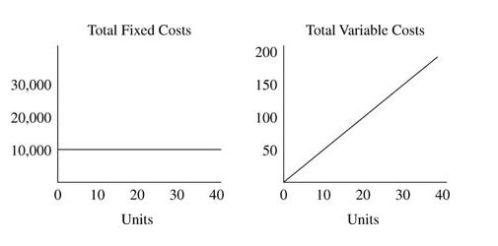

Slide 6
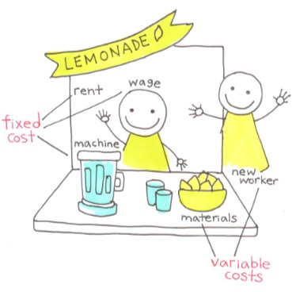

Slide 7
Total Costs (TC)
Total Costs (TC)
Total Variable Cost (TVC)
Total Fixed Cost (TFC)
TC = TFC + TVC

Slide 8
Costs Formulae
TC = TFC + TVC
TVC = AVC x Q
TFC = AFC x Q
Where AVC is the average variable cost, AFC is the average fixed cost and Q is the quantity (or level of output)

Slide 10
EXAM TIP!
Avoid answering ‘circular answers’ in your script, i.e. do not repeat the question in your answers. For example, when asked to distinguish between fixed and variable costs, many students simply state that “fixed costs are fixed and variable costs are variable”. Review key terms that you are unable to define in your own words.

Slide 11
Semi-variable costs
Semi-variable costs contain an element of both fixed and variable costs.
They tend to change only when production or sales exceed a certain level of output.
Example: mobile phone and internet service providers often allow a user to have a predetermined number of “free minutes” or a limit on data usage and charge extra when user exceeds the quota.

Slide 12
Direct vs. Indirect Costs
Direct costs are costs specifically attributed to the production or sale of a particular good or service. It can be traced back to the product and/or to a cost center. Ex. variable costs such as raw materials.
Indirect costs (or overheads) are costs that do not directly link to the production or sale of a specific product, e.g. rent, wages of cleaning staff, and lighting.

Slide 13
EXAM TIP!
The terms indirect costs and direct costs are used when referring to businesses that produce or sell a range of products and therefore operate ‘cost centers’ and ‘profit centers’ (Unit 3.9). These costs can be either fixed or variable costs, depending on the nature of the business. The terms fixed costs and variable costs, as used in break-even analysis (Unit 3.3), are used when referring to the sale or production of just a single type of product.

Slide 14
Exercise Question 3.2.1
Airline Costs

Slide 15
Exercise Question 3.2.2
Calculating Business Costs

Slide 16
REVENUE
Revenue is the money that a business collects from the sale of its goods and services. It is calculated by multiplying the unit price of each product by the quantity sold.
Sales Revenue = Price x Quantity Sold

Slide 17
Revenue Formulae
Total Revenue (TR)
TR = P x Q
Average Revenue (AR)
AR = TR / Q since P = TR/Q
then AR = P

Slide 18
Revenue streams
Revenue stream refers to the money coming into a business from its various business activities, e.g. sponsorship deals, merchandise, membership fees and royalties.
Revenue does not only come from the sale of goods and services. Money can come into a firm from other means depending on the type of firm and its activities.

Slide 19
Other sources of non-sale revenue:
Advertising revenue
Transaction fees
Franchise costs and royalties
Sponsorship revenue
Subscription fees
Merchandise
Dividends
Donations
Interest earnings
Subventions – subsidies offered from the gov’t to certain businesses to help reduce their costs of production.
Notes:
Subventions – usually given to organizations that generate benefits to society such as private schools and hospitals. Also given to help fund R&D.

Slide 20
Example: Revenue streams in the budget airline industry
SpiceJet Ltd. charges for hot meals, snacks and beverages
Jetstar and Scoot loan iPads for a fee
AirAsia customers can pay for the privilege of being seated in a children-free quiet zone
Ryanair failed in its attempt to charge passengers for the use of toilets, but now offers advertising space on its planes, including on the wing tips.

Slide 21
Exercise Question 3.2.3
Goff’s Organic Fresh Fruits (GOFF)

Slide 22
KEY TERMS
REVIEW

Slide 23
COST
Refers to the sum of money incurred by a business in the production process. Example: costs of raw materials, wages and salaries, insurance, advertising and rent.

Slide 24
DIRECT COSTS
Are costs specifically attributed to the production or sale of a particular good or service. Direct costs can be traced back to the product and/or to a cost center.

Slide 25
FIXED COSTS
Are the costs that do not vary with the level of output. They exist even if there is no output, e.g. the cost of rent, management salaries and interest repayments on bank loans.

Slide 26
INDIRECT COSTS or OVERHEADS
Are costs that do not directly link to the production or sale of a specific product, e.g. rent, wages of cleaning staff and lighting.

Slide 27
PRICE
Refers to the amount of money a product is sold for, i.e. the sum paid by the customer.

Slide 28
REVENUE
Is the money that a business collects from the sale of its goods and services. It is calculated by multiplying the unit of price of each product by the quantity sold.

Slide 29
REVENUE STREAM
Refers to the money coming into a business from its various business activities, e.g. sponsorship deals, merchandise, membership fees and royalties.

Slide 30
SEMI-VARIABLE COSTS
Are those that have an element of both fixed costs and variable costs, e.g. power and electricity or salaried staff who also earn commission.

Slide 31
TOTAL COSTS
Are the sum of all variable costs and all fixed costs of production.

Slide 32
VARIABLE COSTS
Are costs of production that change in proportion to the level of output, e.g. raw materials and piece-rate earnings of production workers.
Notes:
Piece rate = advocated by FW Taylor, pays workers for each item that they produce or sell per time period.

